Slide 1
Lecture 3: Control Statements: Part II
C.Y. Chen, Ph.D.
Reference book: Ch4

Slide 2
公告事項
3/15 Exam 1. 座位表將於3/14公布於課程網站

Slide 3
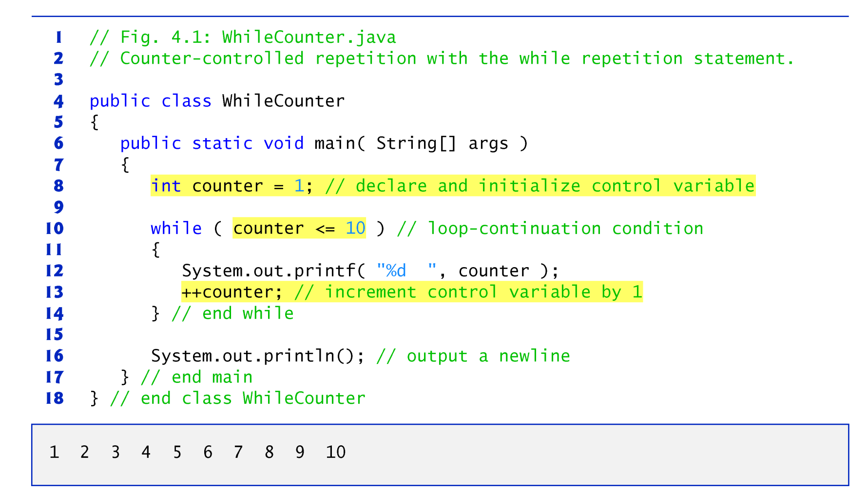
L3-1 Review of counter-controlled repetition
Counter-controlled repetition requires:
____________ (作為計次器)
____________ of the cv
___________________ for the cv
___________________ condition

Slide 4
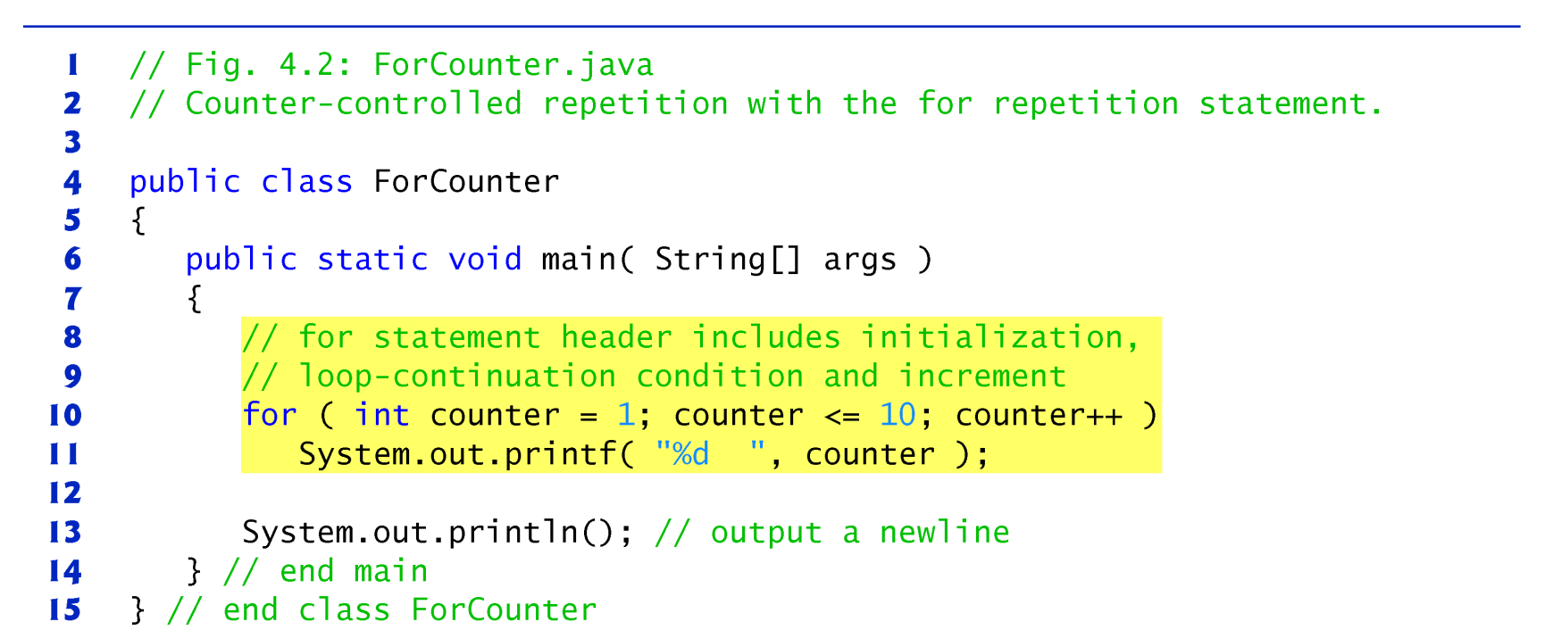
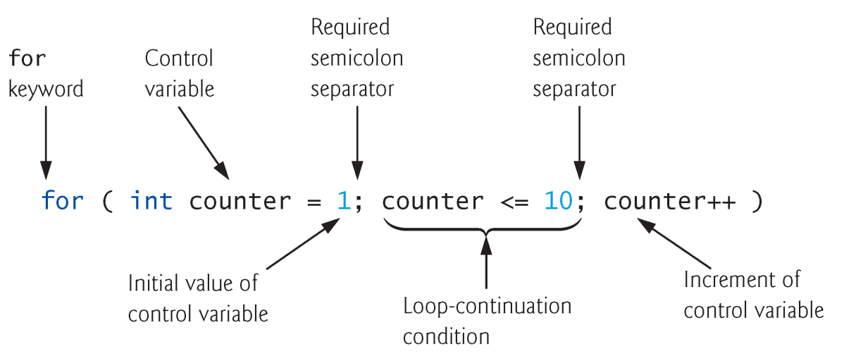
L3-2 The for repetition structure
The for repetition construct:

Slide 5
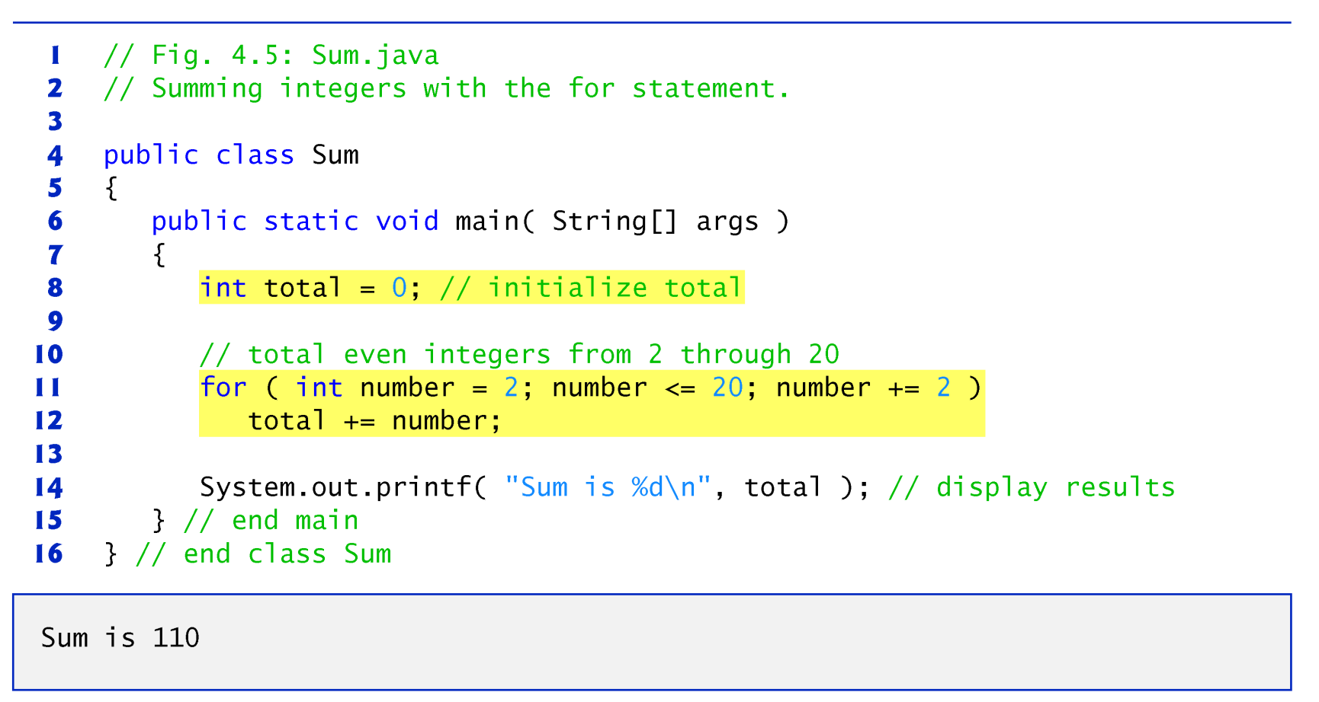
Example (1)

Slide 6
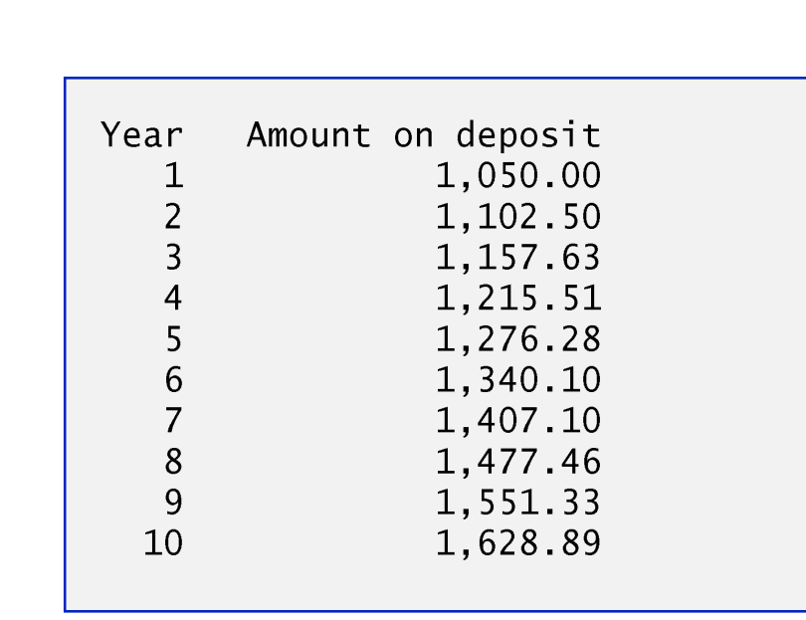
Example (2)
(Case study) Compound interest application: A person invests $1000 in a savings account yielding 5% interest. Assuming that all the interest is left on deposit, calculate and print the amount of money in the account at the end of each year for 10 years. Use the following formula to determine the amounts:
a = p (1 + r)^{n}
where
p 本金 (i.e., the principal) r 年利率 (e.g., use 0.05 for 5%) n 年數 a 第 nth 年底的存款額.

Slide 7
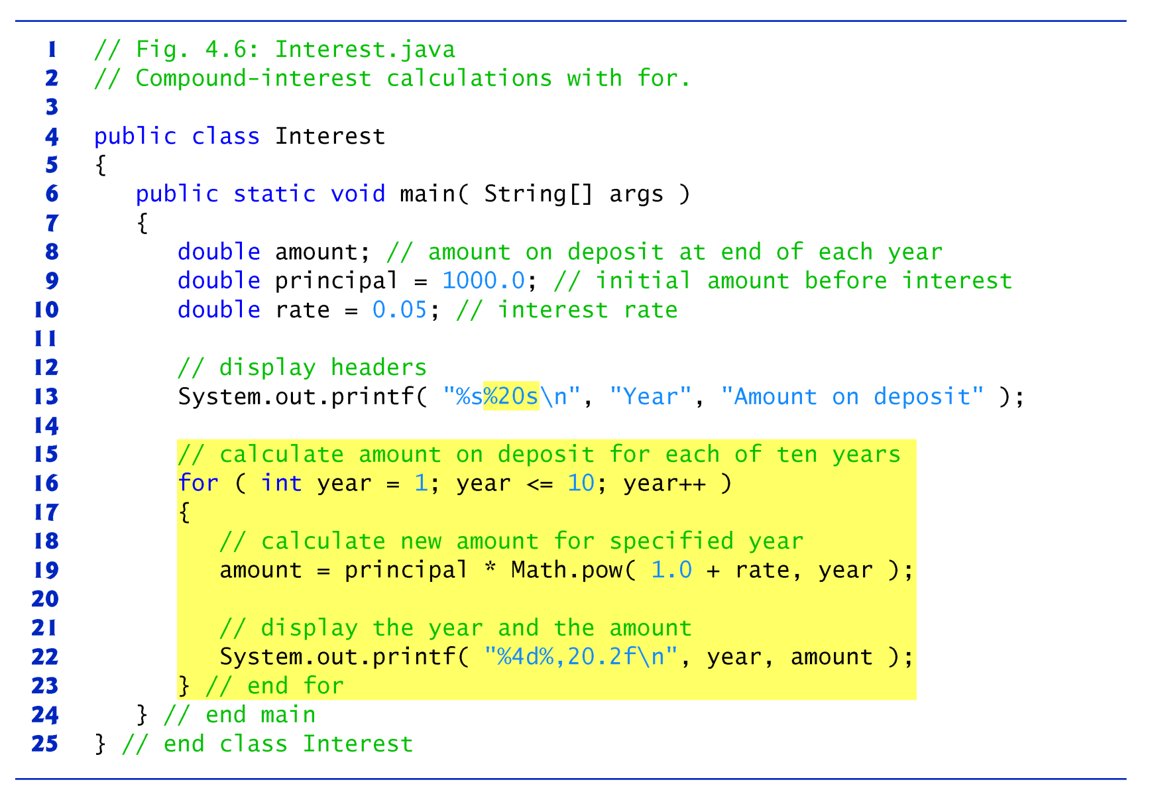
認識新朋友！
java.lang.Math
Notes:
%20s, the string output should be displayed with a field width of 20
To indicate that values should be output left-justified, precede the field width with the minus-sign (–) formatting flag (e.g., %-20s).
If the value to be output is less than 20 character positions wide, the value is right-justified in the field by default.

Slide 8
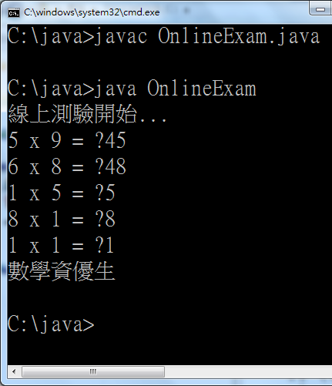
EXE 3_1
繼續線上測驗題，現改用 for 迴圈來實作程式 (寫一支連續5題九九乘法線上隨機出題測驗程式)
答對4題(含)以上者，呈現：數學資優生
答對少於4題者，呈現：要再加油！
自行計時5分鐘

Slide 9
L3-3 The do…while repetition
The do…while repetition statement. Syntax:
➔ the body always executes at least once.
do {
statements…..
} while (contunation_condition);
趣味整理 用程式表達你的愛情觀
while ( 你愛我 ) { 我愛你; }
do { 我愛你; } while ( 你愛我 )
for ( ; ; ) { 我愛你; }

Slide 10
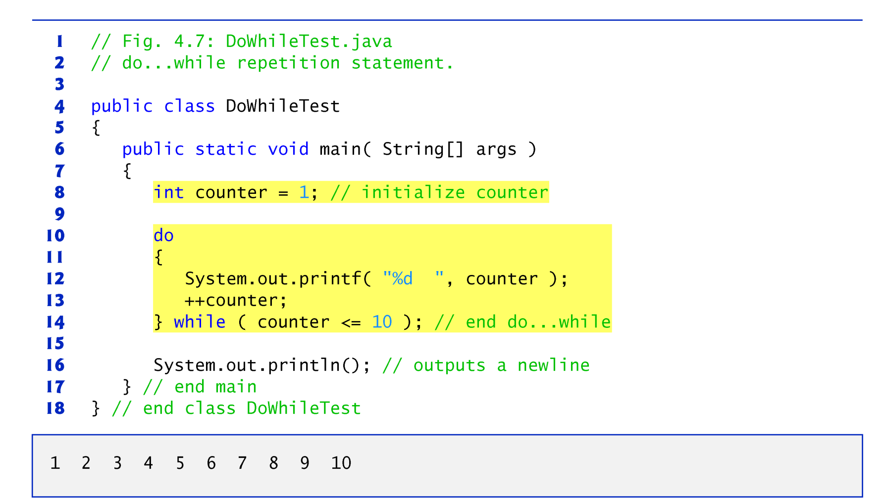
Example

Slide 11
EXE 3_2
繼續線上測驗題，現在改用 do 迴圈來實作程式 (寫一支連續5題九九乘法線上隨機出題測驗程式)
答對4題(含)以上者，呈現：數學資優生
答對少於4題者，呈現：要再加油！
自行計時5分鐘

Slide 12
L3-4 break vs. continue
The _______ statement causes immediate exit from a while, for, do…while or switch construct.
注意：To a select structure, without break, the statements for a matching case and subsequent cases execute.
The ___________ statement skips the remaining statements in the loop body and jump to the next iteration of the loop @

Slide 13
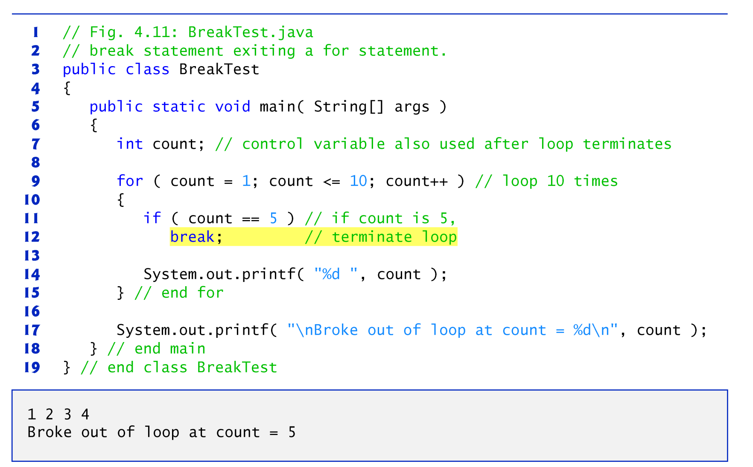
Example (1)

Slide 14
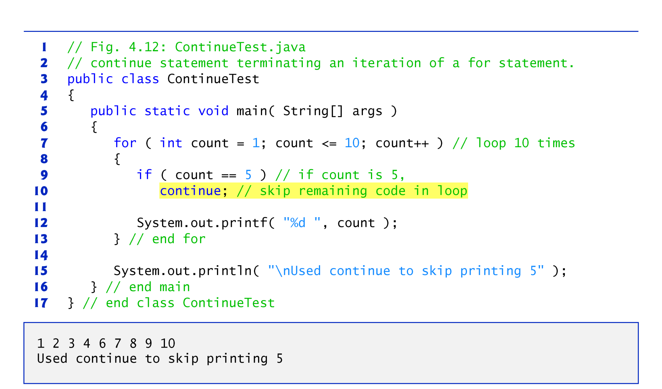
Example (2)

Slide 15
L3-5 Logical operators 邏輯運算子
當選擇/迴圈結構有多個條件時：
And: && ➔須全為true結果才會為true，否則結果為false。
Or: || ➔只要有一為true結果就為true
Not: ! ➔將true變成false, vice versa!
Exclusive or: ^ ➔一個為真且一個為假時 ➔結果為真
a | b | a&&b | a||b | !a | a^b
true | true
true | false
false | false

Slide 16
Example (1): 判斷下列的執行結果：
其實，上述例子並非兩個條件都執行過 ➔此現象稱為 ___________________________, which often occurs when using || and &&.
Example (2) :
int a = 5, b = 5;
boolean c = true;
if(a++ > b && !c) { System.out.println(c); }
else { System.out.println(a); }
boolean a = true;
int b = 65;
if (a == true || ++b >65){System.out.println(b); }

Slide 17
L3-5 Logical operators (Cont’d)
The logical operators: & , | _________ evaluate both of their operands (➔ NO short-circuit situation).
This is useful if the rest operand(s) is required to execute.
Example (3):
boolean a = true;
int b = 65;
if (a == true | ++b >65){System.out.println(b); }

Slide 18
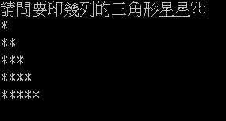
L3-6 迴圈的巢狀結構Nested Loops
The body of a loop (called________________) can contain another loop (called_________________).
EXE 3_3: (先5分鐘自行試試)
import java.util.Scanner;
public class Exercise3_3{
public static void main(String args[]){
int row;
Scanner input = new Scanner(System.in);
System.out.print(“請問要印幾列的三角形星星?");
row = input.nextInt();
for(int i=1; i<= row; i++){
}
}
}
18
18

Slide 19
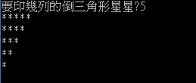
Example (1):
……
for(int i=row; i>= 1; i--){
for (int j = 1; j <= i; j++){ System.out.print("*"); }
System.out.println();
}
……

Slide 20
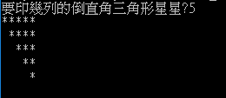
More Example (2):
……
for(int i=0; i<row; i++){
for(int j=1; j<=row; j++) {
System.out.print(j<=i ? " " : "*");
}
System.out.println();
}
……

Slide 21
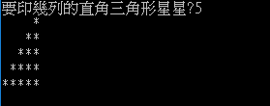
More Example (3):
……
for(int i=row; i>0; i--){
for(int j=1; j<=row; j++){ System.out.print(j<i ? " " : "*");
}
System.out.println();
}
……

Slide 22
L3-7 Java GUI programming: 圖像化互動的程式運作
應用程式的執行是一連串與使用者互動的過程
我們已學過如何在純文字的作業環境(DOS)上進行人機互動
若要圖像化互動，可利用Java API的JOptionPane class
透過該class的一些方法，程式可產生圖像化對話方塊來呈現訊息、警示使用者、使用者輸入資訊或選項等以活潑化使用互動過程
JOptionPane 是屬於哪一個套件?
目前已應用到哪兩個套件？
22

Slide 23
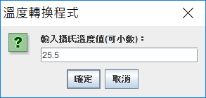
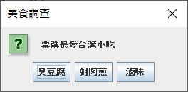
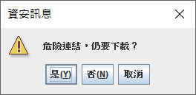
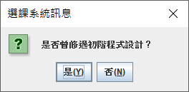
輸入方塊 (Input dialogs)
選擇方塊 (Option dialogs)
showInputDialog
showOptionDialog
訊息方塊 (Message dialogs)
確認方塊 (Confirmation dialogs)
showMessageDialog
showConfirmDialog
接下來老師會介紹其中兩種。剩下的要訓練你自行至JDK Docs了解
23

Slide 24
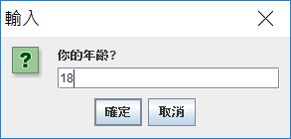
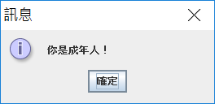
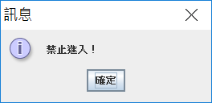
Example (1)
應用JOptionPane的showInputDialog()來產生輸入方塊。陽春版：
Design an input box asking for the user’s age. Then have a message dialog box to respond if the age >=18.
It’s time!
如何查閱JDK Docs以探索Java應用套件…

Slide 25
import javax.swing.JOptionPane;
public class Entrance{
public static void main(String arg[]){
int age = 0;
String input = JOptionPane.showInputDialog("你的年齡?");
age = Integer.parseInt(input);
if (age >=18)
{ JOptionPane.showMessageDialog( null, "你是成年人！"); }
else
{ JOptionPane.showMessageDialog( null, "禁止進入！"); }
System.exit(0);
}
}
來自API的新朋友：Integer, Double!!
➔將字串轉成整數：Integer.parseInt(字串值)
➔將字串轉成浮點數： Double.parseDouble(字串值)
25

Slide 26
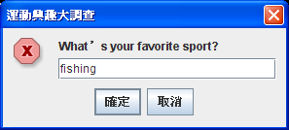
豪華版對話方塊
以輸入方塊為例 showInputDialog(Component parent, Object message, String title, int messageType);
Message icon (messageType):
0 禁止標誌 1 訊息標誌
2 危險標誌 3 問號標誌
Example：
➔ String input = JOptionPane.showInputDialog(null, "What’s your favorite sport?", "運動興趣大調查", 0);

Slide 27
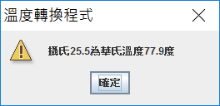
Example (2)
import javax.swing.JOptionPane;
public class Temperature{
public static void main(String arg[]){
double c = 0.0, f = 0.0;
String input = JOptionPane.showInputDialog(null, "輸入攝氏溫度值(可小數):”, "溫度轉換程式", 3);
c = Double.parseDouble(input);
f = 9*c/5 + 32;
JOptionPane.showMessageDialog( null, "攝氏" + c + "為華氏溫度" + f + "度","溫度轉換程式", 2 );
System.exit(0);
}
}

Slide 28
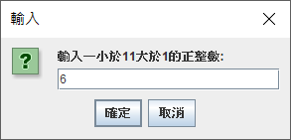
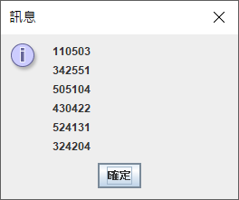
EXE 3_4 (8分鐘)
利用for巢狀迴圈寫出如畫面的亂數矩陣
功能需求：產生一輸入方塊讓使用者輸入一小於11大於1的正整數(例如a)，電腦即產生小於a的隨機整數且邊長皆為a之亂數矩陣
使用陽春版輸入方塊即可

Slide 29






考前整理：來自Java API的好幫手永不嫌多
Scanner
__________
__________
__________
__________
JOptionPane
__________________
__________________
__________________
__________________
Random
___________
Double
______________
Integer
_________
Math
______
其中哪兩個須先成立物件？

Slide 30

本次學習重點
Selection structures: if & switch
Repetition structures: while, do-while, & for
The break & continue statements
More of operators: (8)logical operators. Previously: (1)arithmetic, (2)relational & equity, (3)assignment (4) compound assignment, (5)conditional, (6)casting, (7)increment/decrement,
Basic Java programming of graphical user-interaction using JOptionPane
Inner and outer looping structures
要熟悉Java JDK的六個classes: (1)Scanner, (2)Random, (3)Joptionpane, (4)Double, (5)Integer, (6)Math @

Slide 31
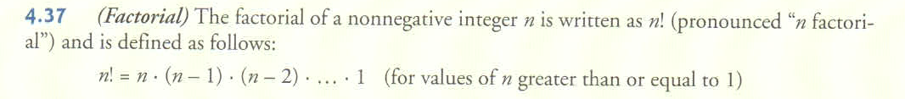
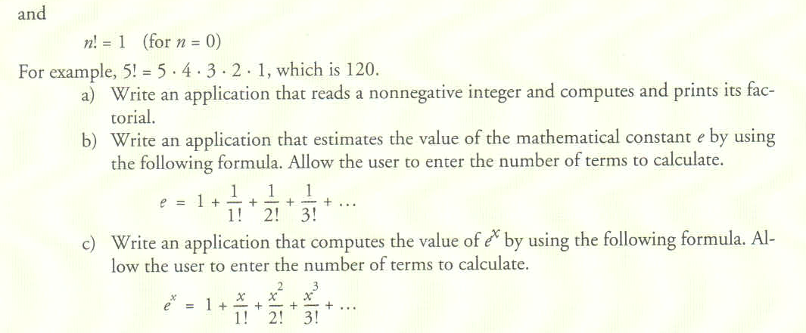
More Self-Exercises (Take home)
No need to hand in.解答下週至網站下載

